Slide 1
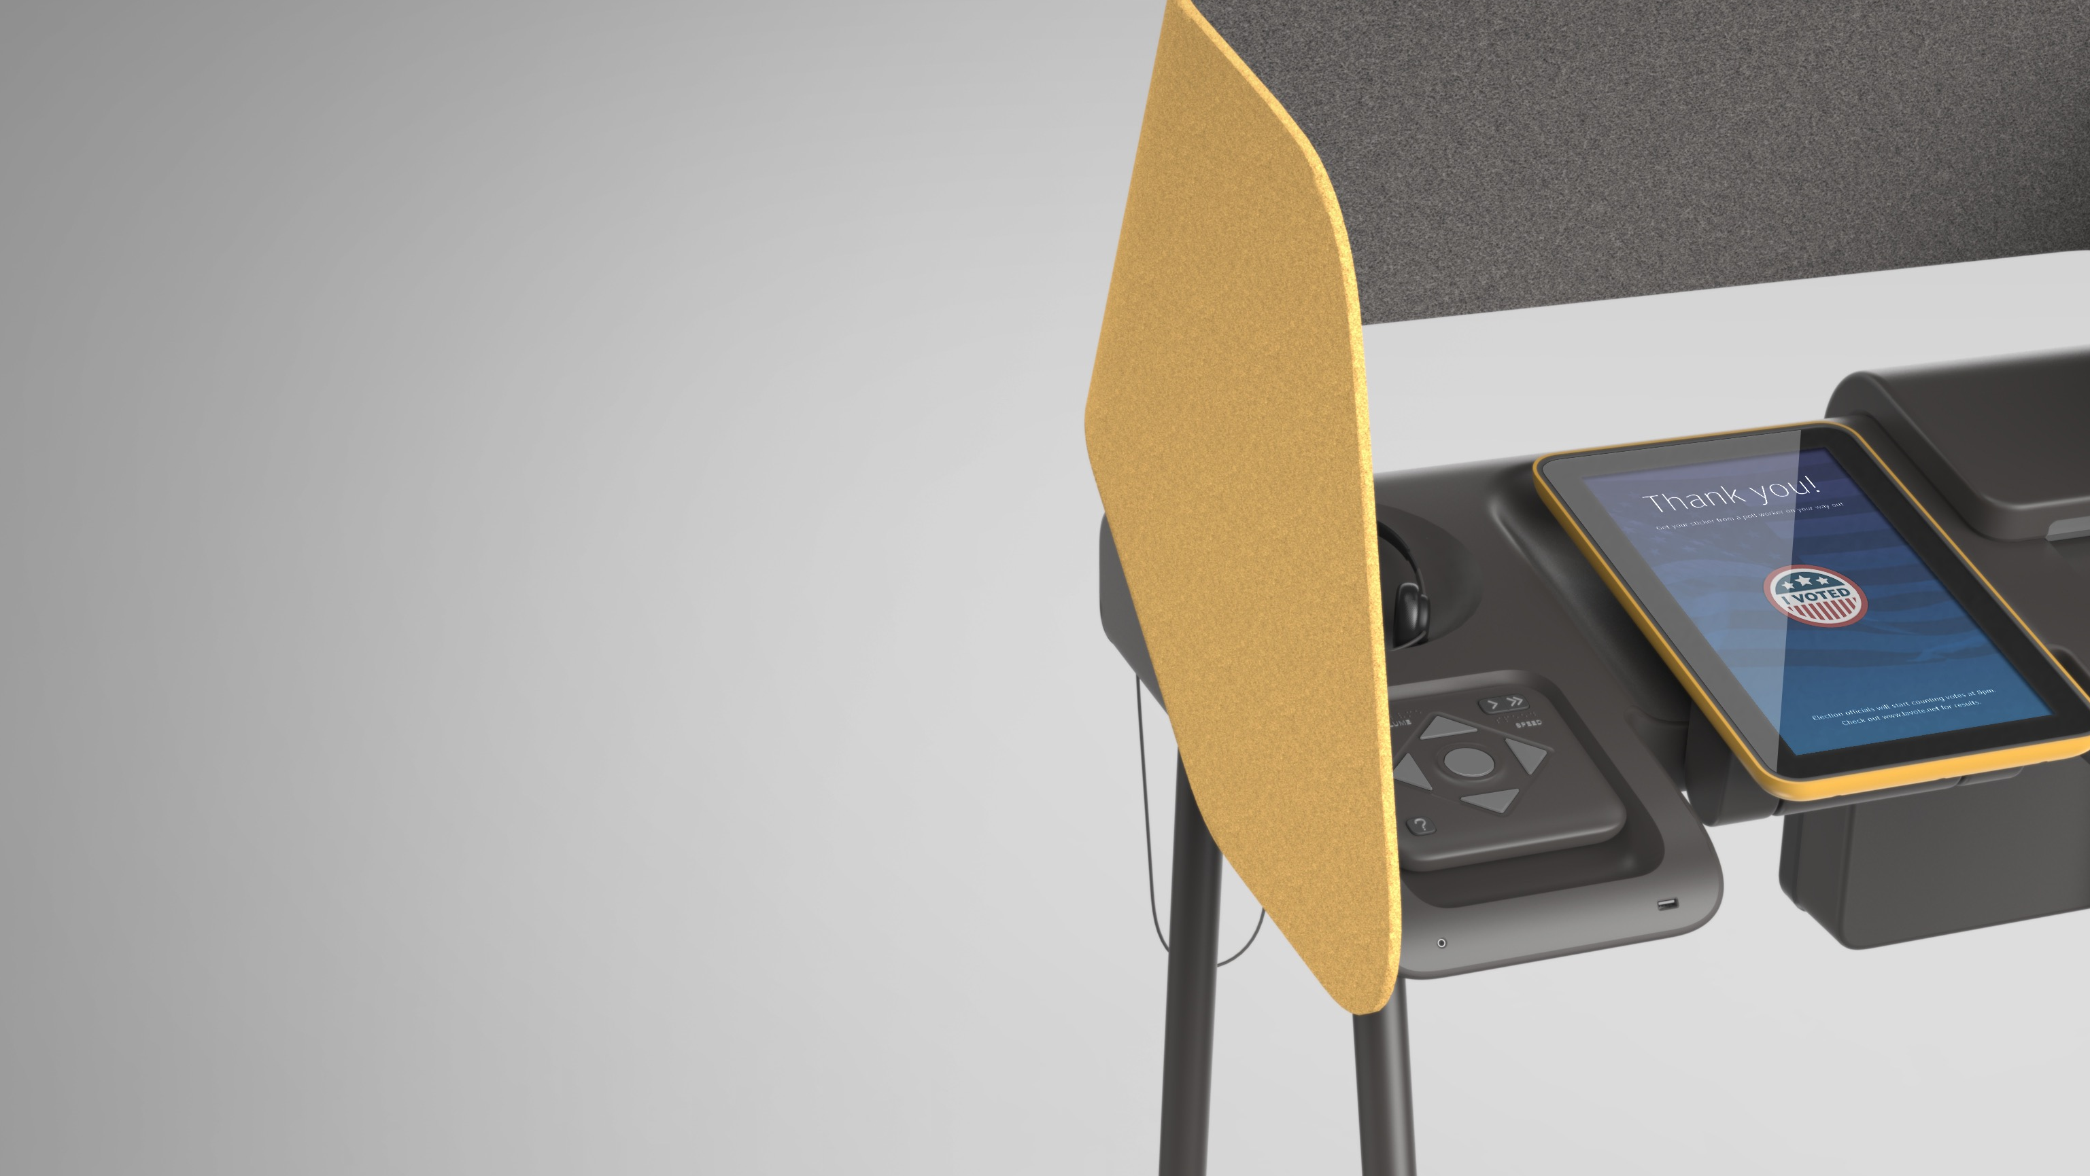


Voting Systems Assessment Project
Vendor Day
May 10, 2017
County of Los Angeles
Registrar-Recorder/County Clerk
Notes:
Good morning. My name is Kenneth Bennett, the VSAP Program Manager. On behalf of Los Angeles County, welcome to VSAP Vendor Day.

Slide 2
Vendor Day Agenda
9:30 – 9:45 AM: | Vendor Day Objectives and Ground Rules
9:45 – 10:15 AM: | VSAP Overview
10:15 – 11:00 AM: | VSAP Scope
11:00 – 11:15 AM | Q&A on VSAP Scope
11:15 – 12:45 PM: | Break Out: Demonstrations
12:45 – 1:45 PM: | Lunch
1:45 – 2:45 PM: | Q&A
2:45 – 3:00 PM: | Closing Remarks
3:00 – 4:00 PM: | Vendor Networking and Additional Demonstration Time
Notes:
Overview of today’s agenda

Slide 3
Vendor Day Objectives
Give potential vendors an opportunity to learn more about the VSAP vision and scope directly from Los Angeles County
Provide vendors with a “hands on” experience with the Ballot Marking Device prototype and with the New Tally System prototype
Engage vendors in a dialogue that will inform vendors of the County’s plans and expectations, and inform the County of areas in which vendors need additional clarification
Provide vendors an opportunity to meet each other and consider potential partnership opportunities
Notes:
We have 4 main objectives for today.
The County has put in a lot of effort to think through what the future of voting in Los Angeles County should look like. Today is an opportunity for you to hear directly from us on the Voting Systems Assessment Project journey which led us to the vision and scope.
We want to provide you with a hands-on experience of 2 prototypes: the Ballot Marking Device and the New Tally System.
The intent of issuing a Request for Information was to hear directly from the vendor community on the County’s vision and strategy for VSAP. Today, we want to have a two-way conversation in real-time.
While the County will be providing a lot of information today, another key objective of Vendor Day is for you all to meet each other. In the RFI we highlighted that the County is looking to partner with a Strong Systems Integrator. Vendor Day is an opportunity for the vendors to begin conversations on whether it makes sense to partner for an eventual solicitation/contract.

Slide 4
Ground Rules for Today
Please hold questions till the end of presentations. We will also have a formal Q&A session this afternoon.
  The County will capture the questions asked today and will post, along with any written questions submitted, answers on the VSAP RFI website by May 19th.
  Written Questions are due by Friday, May 12, 2017 at 5:00 PM PST
A list of vendors in attendance today will be shared with today’s attendees.
  Vendors are encouraged to share contact information among each other and submit contact information on the VSAP RFI website.
Pictures are allowed during Vendor Day.
Today’s presentation will be posted on the VSAP RFI website.
Notes:
[Review Ground Rules]
I would now like to introduce Dean Logan, the Los Angeles County Registrar-Recorder/County Clerk, who will provide an overview of the VSAP journey.

Slide 5
VSAP Overview

Slide 6




Introductions

Slide 7
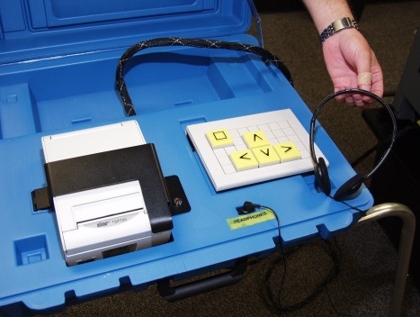
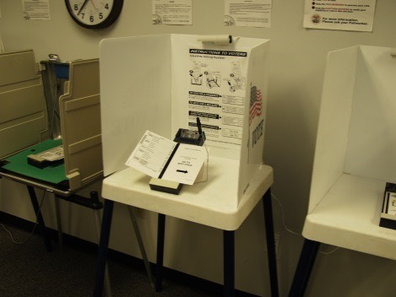
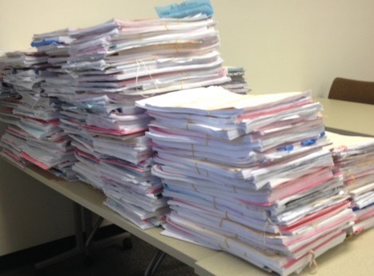
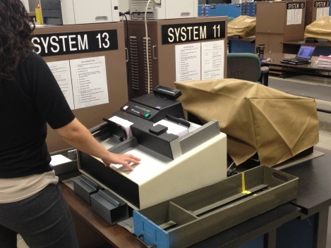
Background
Outdated process and technology
Need to replace existing system
InkaVote Plus extended past its lifespan
Antiquated technology
No suitable system available in the market
County is the largest and most complex election jurisdiction
Regulatory environment has inhibited innovation
Notes:
Voters are unfamiliar with the technology and don’t understand it
Outdated regulations no longer make sense
Processes were designed for life in the 1800s

Slide 8
Background
Need to reimagine a voting experience that is more convenient and accessible for voters and easier for them to understand.
Meet voter expectations for:
Contemporary technology
Processes aligned with today’s lifestyles
Expanded options
Notes:
The size and diversity of Los Angeles County and the limitations of the commercial voting systems product market argue convincingly for the need for innovation.

Slide 9
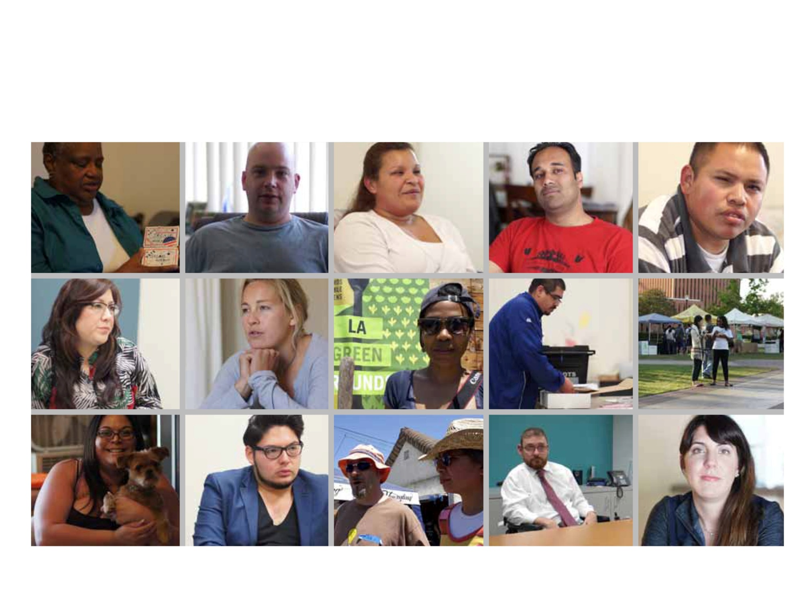
Vision
Transform the voting experience for voters in Los Angeles County and beyond
Notes:
In response to the County’s needs and challenges, VSAP takes an unprecedented and comprehensive approach at modernizing the County’s voting experience.
The vision of the project is to implement a voting experience, and the systems that support it, through a human-centered, transparent process that considers the needs and expectations of current and future Los Angeles County voters.

Slide 10
Goals of VSAP
Implement a new voting experience that is voter-centered and sensitive to the human experience
Implement publicly-owned voting systems
Spur technology innovation in the voting experience
Encourage a regulatory environment that allows for development, certification and implementation of publicly owned, voter-centered systems
Pursue innovative business models for voting system development and implementation
Make VSAP research and solutions available beyond the County

Slide 11
New Voting Experience

Slide 12
Current Status
Complete
Complete
Complete
In Progress
Phase I:
Public Opinion
Baseline Research
(Sep 2009 – Jul 2010)
Phase II:
Establishment of Principles
(Jan 2011 – Dec 2011)
Phase III:
System Design and Engineering
(Jan 2012 – July 2016)
Phase IV:
Manufacturing and Certification
(Aug 2016 – Jun 2020)
Phase V:
Phased
Implementation
(Jun 2018 – Jun 2024)
2010
2011
2016
2018
2024
Notes:
In Phase I, we conducted research and gathered a lot of data focusing on evaluating the current voting system and experience, and learning what voters expect of the future voting system. The research revealed that voters expect more than just an upgrade in voting technology, and modernization efforts needed to improve the entire voting experience.
In Phase II, we established the VSAP Advisory Committee – a formal engagement body composed of stakeholders and advocates in elections who represent different communities within the County electorate. Additionally, we created and adopted the 14 General Voting System Principles.
In Phase III, we moved VSAP from research to design and development of the new voting system. The VSAP Technical Advisory Committee was established in this Phase – providing VSAP with the necessary technical expertise in voting technology, security, transparency and accessibility during voting system design. We also launched an Open Design Search, which resulted in over 150 concepts for improving the voter experience for Los Angeles County voters.
a) In 2013, we engaged IDEO to help us translate the data and concepts the County has gathered into refined designs. The work produced design and engineering specifications for a new voting experience. Additionally, they created the Ballot Marking Device prototypes which you will have the opportunity to experience here today.
4. We are currently in Phase IV, and the RFI and today’s Vendor Day is a key aspect. In the near term, this phase will also include contract solicitations, evaluation and selection of contractors to manufacture and help implement the new voting system.

Slide 13
VSAP Scope
Notes:
The County has invested a great deal of resources and time in the design of the VSAP Components. It is now looking for a partner to help us implement.

Slide 14
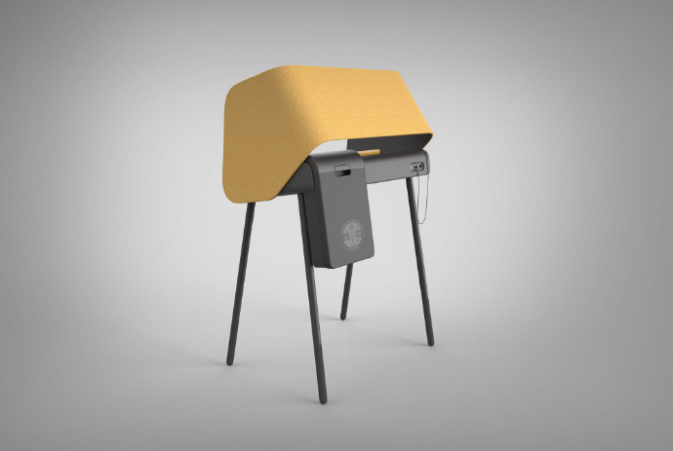

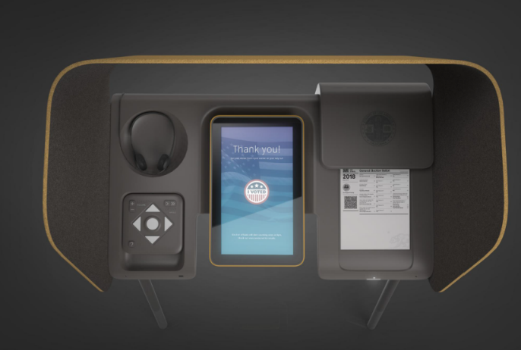
Ballot Marking Device
Finished design of the UI flow, CAD drawings, design specifications and bill of materials
Custom-designed with three distinct interfaces:
  Touchscreen with optional audio read back
  Audio and tactile controller with touchscreen on/off options
  Dual switch input with optional video
Voters can use the Ballot Marking Device to generate, print, verify and cast a paper ballot
Designed to facilitate voting for voters with a wide range of cognitive and physical limitations, and language needs
The thermal print mechanism needed for the BMD and the BAM printer is not available for purchase from the marketplace
Notes:
The BMD records the voter’s selections on the ballot in human readable text and encodes the selections in a machine-readable QR Code format.
Once the voter has marked his/her intended votes, the BMD will print a market paper ballot for the voter to review and validate, ensuring it reflects their selections.
The BMD supports hands-free casting of the paper ballot into an integrated ballot box.
All voters will be able to vote on the same device by customizing their experience.

Slide 15
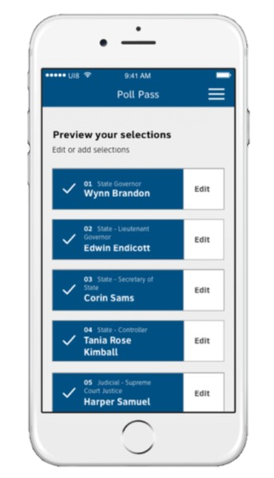
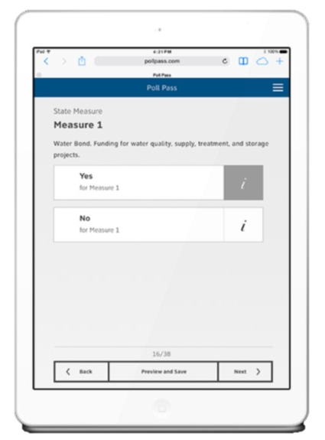
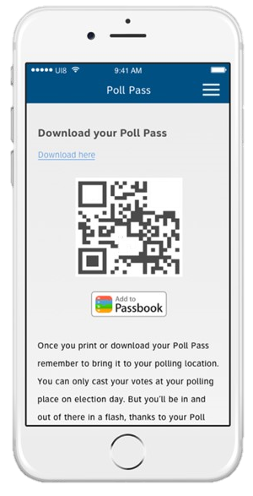
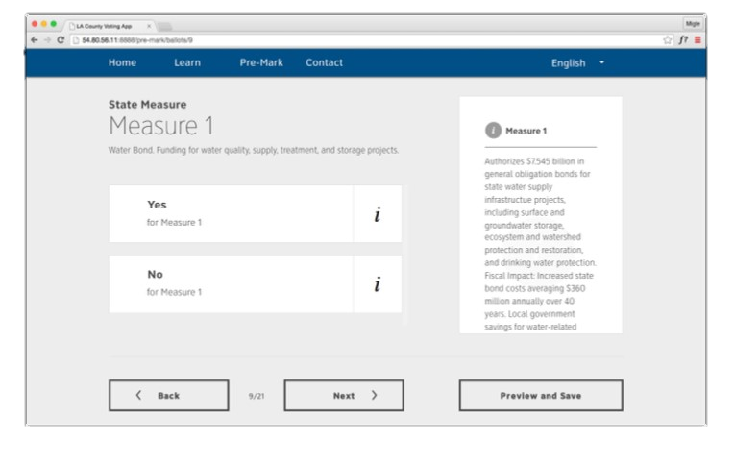
Interactive Sample Ballot
Finished design of the UI flow and high-level design definition of the systems and data architecture
Provides a digital means of presenting sample ballot material that is highly engaging and accessible.
Expedites voting by allowing voters to pre-mark their selections and generate a QR Code that may be used at the voting location using the BMD.
Notes:
The Interactive Sample Ballot enables prospective voters to review and pre-mark their respective sample ballot at their own pace via their desktop computer or mobile device prior to casting their vote.
The ISB will be integrated with ECBMS to receive the necessary data.

Slide 16
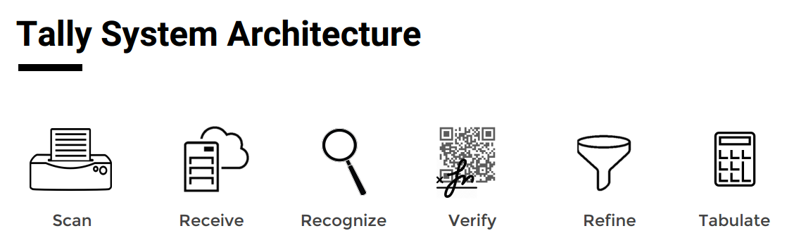
Tally System
Notes:
A new Tally System will be required to capture and process ballot images so that vote selections on paper ballots, including ballots cast at Vote Centers and Vote by Mail ballots, can be digitally counted.
Design benefits:
- Message brokering
- Transparency
- Ballot-level auditability
- Flexibility and scalability
RR/CC is in progress on developing software for the new Tally System. The County VSAP Tally Project Team has completed an Advanced Proof of Concept prototype for the VSAP Tally solution and is currently developing prototype software; the APOC is here today for you to experience an in-person demonstration.
The prototype is expected to be completed prior to contracting with the awarded vendor following the planned contract solicitations.
RR/CC anticipates contracting with an awarded vendor to review and potentially revise the developed prototype, provide the necessary documentation, and be responsible for obtaining certification by the CA Secretary of State.

Slide 17
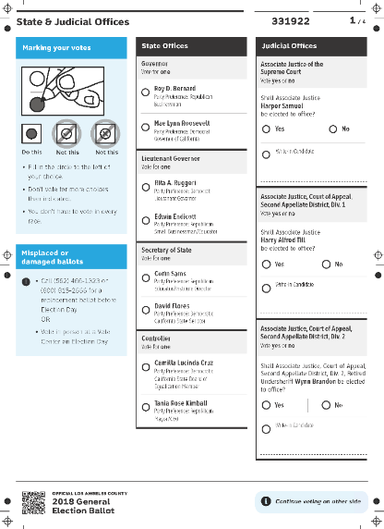
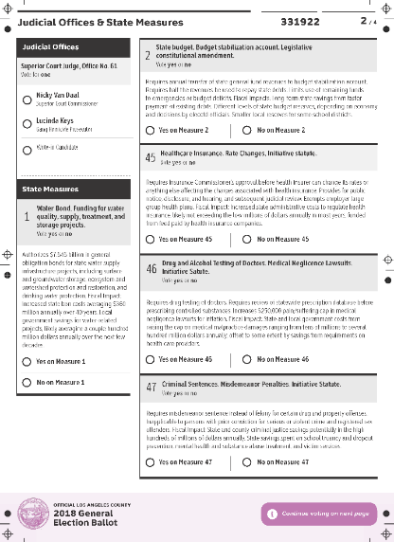
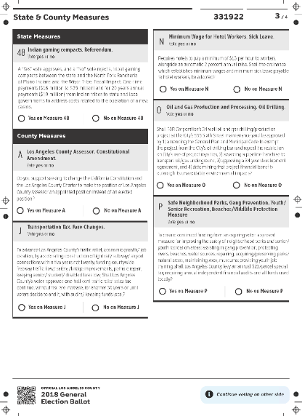
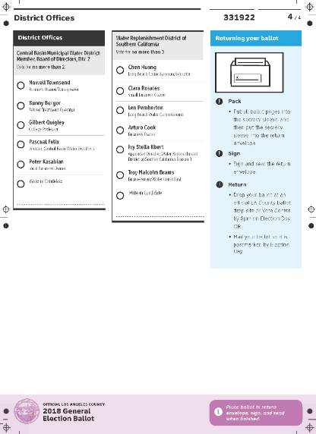
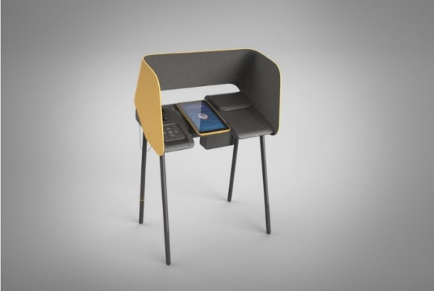
Election Contest and Ballot Management System Integration
The Election Contest and Ballot Management System (ECBMS) manages candidate filing and ballot layout processes
Integration will be required between ECBMS and the New Tally System, Interactive Sample Ballot and the BMD Manager
Notes:
New ECBMS functionality related to the Vote By Mail (VBM) and Ballot Marking Device (BMD) ballot layout as well as the data feed required to integrate with the Interactive Sample Ballot (ISB) is currently being prototyped by RR/CC to accommodate the future state and is expected to be completed prior to contracting with an awarded vendor.
There a various mechanisms to achieve the integration needs and the County is looking for vendors to propose the best value approach.

Slide 18
Intellectual Property and Open Source Licensing
The County will retain the Intellectual Property (IP) ownership rights of the VSAP voting system, with the exception of IP created for certain hardware components (e.g., thermal printers).
Intent of IP ownership is to:
  Ensure public ownership of the rights to manage the use and transparency of the voting systems
  Ensure public trust
  Protect public interest
The County is open to various open source licenses so long as it permits transparency and the ability to share IP and the technology.
Notes:
The County is not interested in entering the market as a vendor.
The County is considering how an independent non-profit organization could serve as the repository and administrator of the resulting VSAP IP.
The County is seeking candid feedback from the vendor community on the IP approach for VSAP as part of the RFI Response.

Slide 19
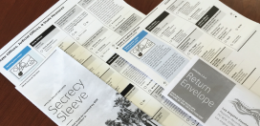
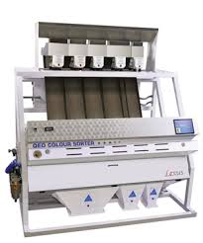

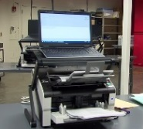

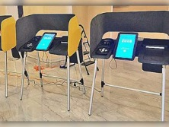
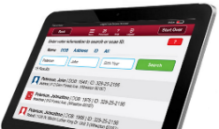
Systems Integrator Scope
Vote by Mail (VBM)
Signature Verification
Voter Registration
Printing
Assembly
Mailing
Sorting
Ballot design
Ballot layout
ECBMS
Scanners
Software
Hardware
Election Results
Storage
Elections Management System
Tally System
Software
Hardware
Interactive Sample Ballot
Software
Hardware (Tablets, Accessibility Devices, Ballot Drop Box)
Printers
QR Code Readers
Furniture (Privacy Screen, Table, Legs)
Ballot Marking Device (BMD)
ePollbook hardware
ePollbook software
BAM Printer
ePollbook
Legend
Out of Scope
In Scope
Notes:
The Systems Integrator will be responsible for the overall development and implementation of all components that are in scope for VSAP.
This includes obtaining certification by the California Secretary of State.
RR/CC will also require ongoing maintenance and support services for all components that are in scope for VSAP, with the potential exception of the Tally System.
- This includes continued upgrade of all software components, and servicing and report of BMDs.

Slide 20
Project Timeline
Phase I:
Public Opinion
Baseline Research
(Sep 2009 – Jul 2010)
Phase II:
Establishment of Principles
(Jan 2011 – Dec 2011)
Phase III:
System Design and Engineering
(Jan 2012 – July 2016)
Phase IV:
Manufacturing and Certification
(Aug 2016 – Jun 2020)
Phase V:
Phased
Implementation
(Jun 2018 – Jun 2024)
2010
2011
2016
2018
2024
2020
Full
Implementation
2018
Pilot
2024
Universal VBM
Notes:
LA County envisions rolling out VSAP in multiple phases in a manner that can best balance the implementation risks with the risks in continuing to conduct elections with the current, aging voting systems.
The targeted VSAP implementation timeline is as follows:
2018 Election (Pilot): New Tally System, Tally System scanners, newly designed Vote By Mail ballots, Ballot Marking Devices (hardware and software) for Early Voting, and Interactive Sample Ballot (software)
2020 Election (Certification Achieved): New Tally System, Vote By Mail, Ballot Marking Devices deployed at Vote Centers, and Interactive Sample Ballot

Slide 21
Q&A on VSAP Scope

Slide 22
Break Out: Demonstrations

Slide 23
Demonstration Instructions
Those with a blue border on your name tag, proceed to the Ballot Marking Device demonstrations. Those with yellow border on your name tag, proceed to the Tally System demonstration. You will then switch rooms for the second session.
  11:15 AM – 12:00 PM: Session #1
  12:00 PM – 12:45 PM: Session #2
Notes:
There is a lunch break from 12:45 – 1:45 PM. A list of nearby restaurants is provided.
The Q&A period will begin at 1:45 PM.

Slide 24
Q&A

Slide 25
Q&A Panel
Dean Logan | Registrar-Recorder/County Clerk
Debbie Martin | Chief Deputy Registrar-Recorder/County Clerk
Rita Figueroa | Assistant Registrar-Recorder/County Clerk – Administration Bureau
Kenneth Bennett | VSAP Program Manager
Monica Flores | VSAP Administrative Manager
Henry Balta | Senior Associate CIO Los Angeles County

Slide 26
Closing Remarks

Slide 27
RFI Timetable
Written Questions Due | Friday, May 12, 2017 at 5:00 PM PST
County’s Responses to Written Questions | Friday, May 19, 2017
RFI Responses Due | Friday, May 26, 2017 at 5:00 PM PST
Notes:
Thank you very much for taking the time to join us today at Vendor Day. We hope you learned a lot more about the County’s vision for the future voting experience, and are now as excited as us.
We look forward to receiving your responses to the RFI. Responses are due by Friday, May 26th by 5 PM PST.
If you have any questions, please be sure to submit them in writing by Friday, May 12th. The County plans to post responses to the written questions by Friday, May 19th.

Slide 28
Stay Engaged
Website: http://vsap.lavote.net/request-for-information/
Email: contracts@rrcc.lacounty.gov
Register with LA County: https://camisvr.co.la.ca.us/webven/
Notes:
We encourage you to check the VSAP website often for any updates. There is also a form for vendors to include their contact information, which will be published, to further encourage vendor conversation and potential partnerships.
To be made aware of and gain access to eventual contract solicitations, we encourage you to register with Los Angeles County.

Slide 29
Networking

